Slide 1
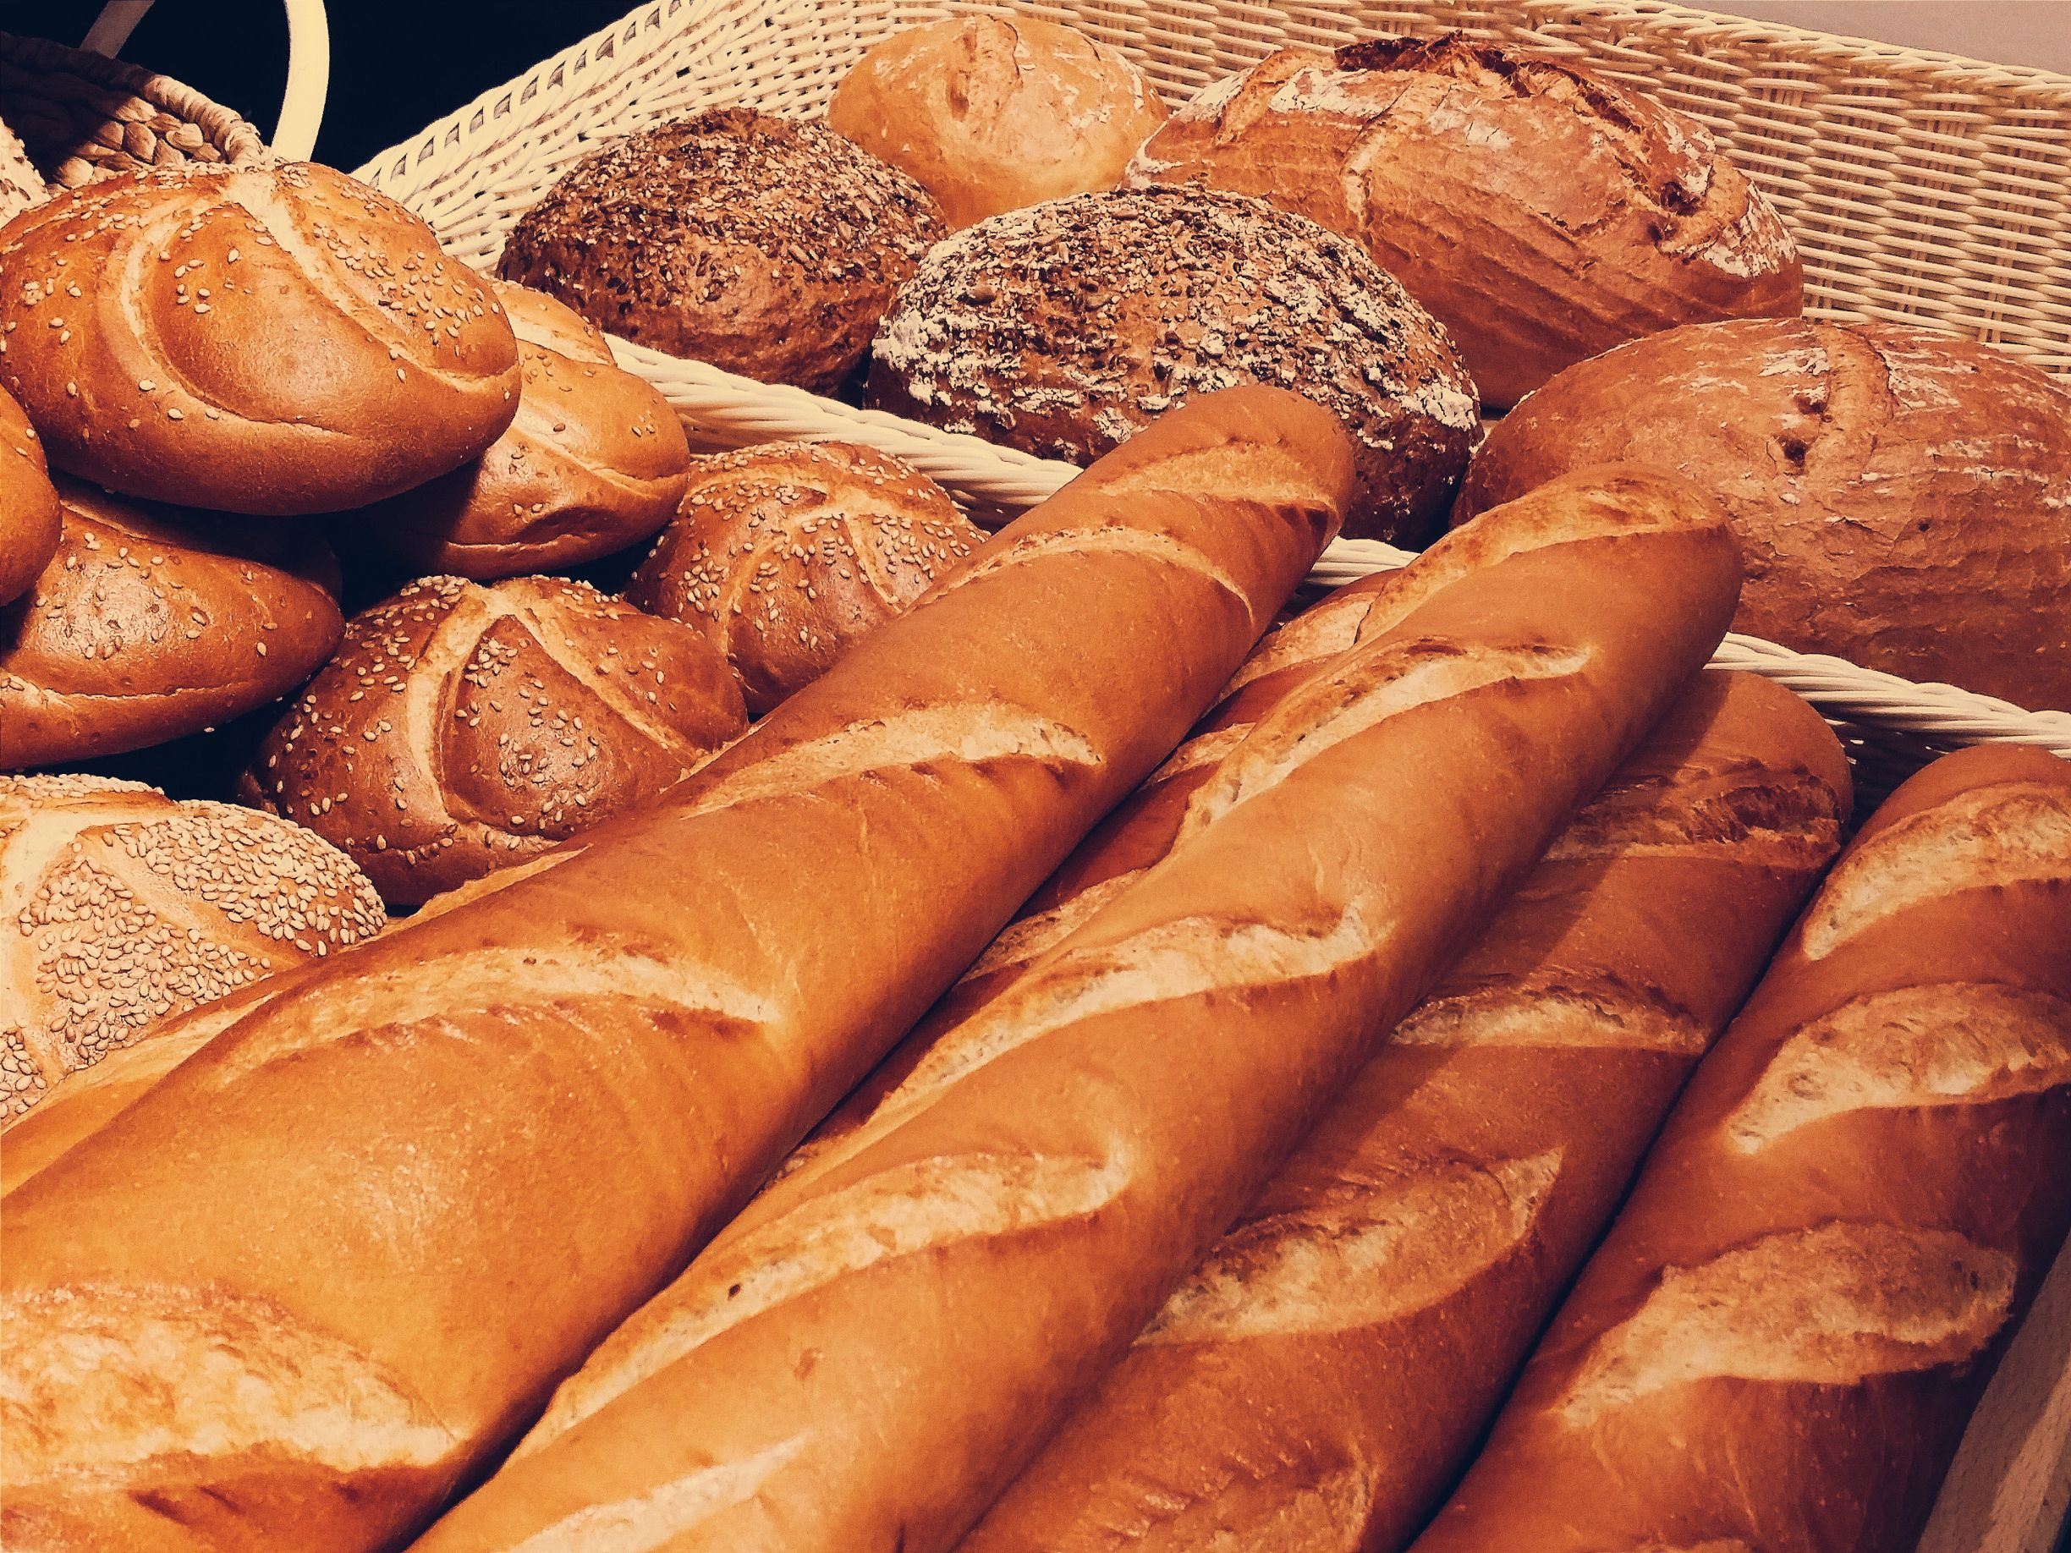
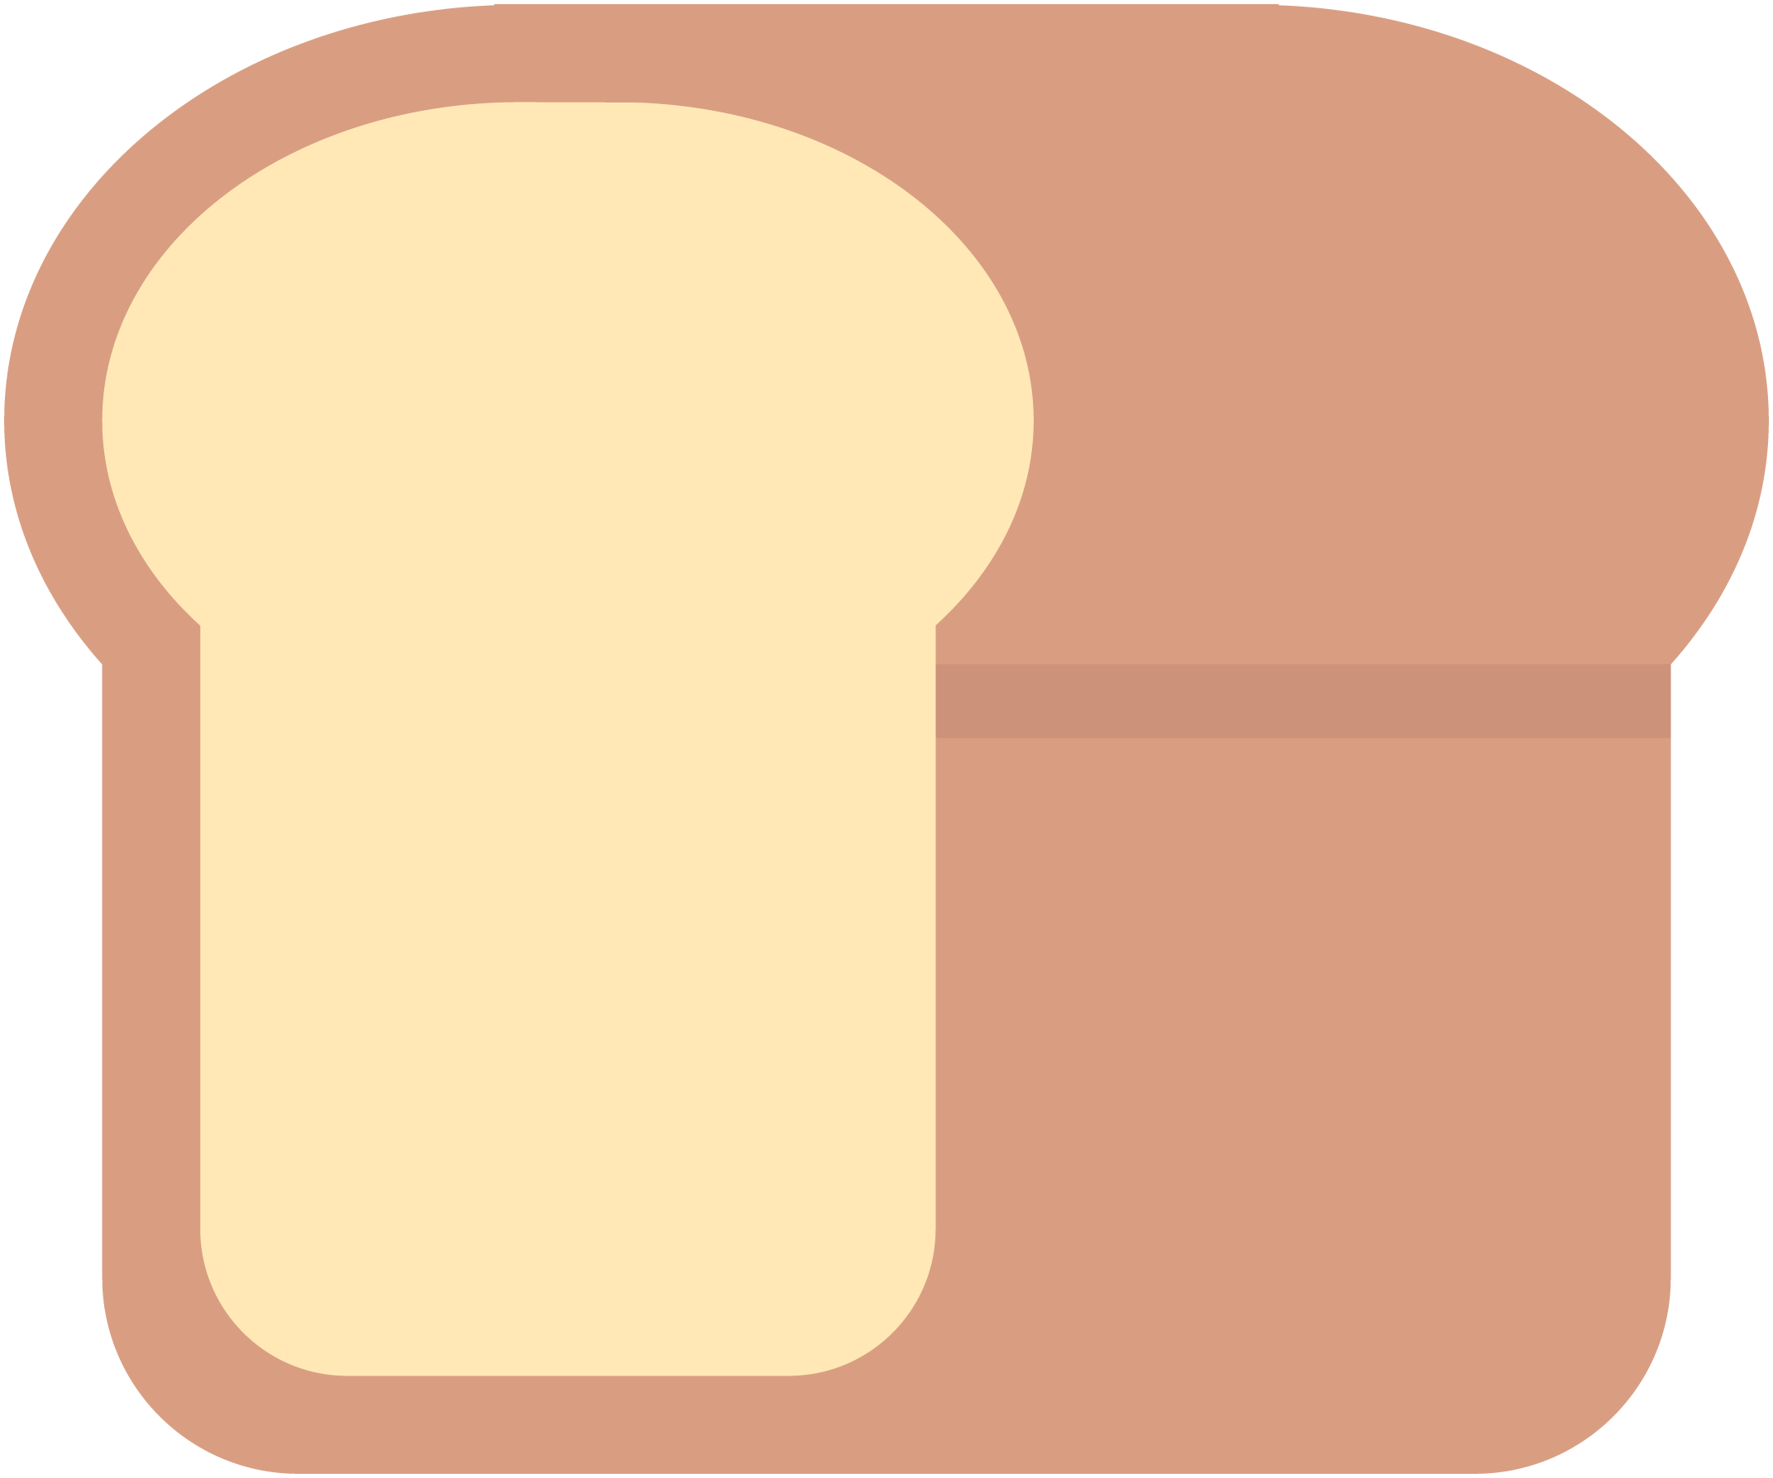
Analysis Proposal
LoafGo
Demo Day
Notes:
Not sure how to start off the presentation with this first slide thoughts?
Thoughts on the slide theme of the presentation?
The slides will go in the following order
Team Structure
Client Domain and problem
Solution per client need -3 slides
Technical Solution
TimeLine

Slide 2

Team
Carlos Villamar
Product Manager
Darion Wood
Architect
Samantha Burnett
UX Design Lead
Donleys Familia
Support/Tester
Jinat Rezwana
Support/Tester
Ali Mohamed
Support/Tester
Using ROR 5 + Ruby 2.4
Notes:
Here is a slide showcasing the teams structure, The roles as they stand currently are just placeholder for the presentation but it is something we need to have set in stone going forward as we finalize the scope of the project were we all will be responsible for building the system. Below are just some notes and some definitions of the roles.
Ideally I would like to place headshots of all of us next to our names
Product Owner will take the clients needs and develop a solution or a vision to meet those needs and will define them Cleary and effectively
Architecture Owner is the person who will build a technical roadmap to build the solution
UX stands for user experience
Support/Tester are the developers who will help build components of the system and test them

Slide 3
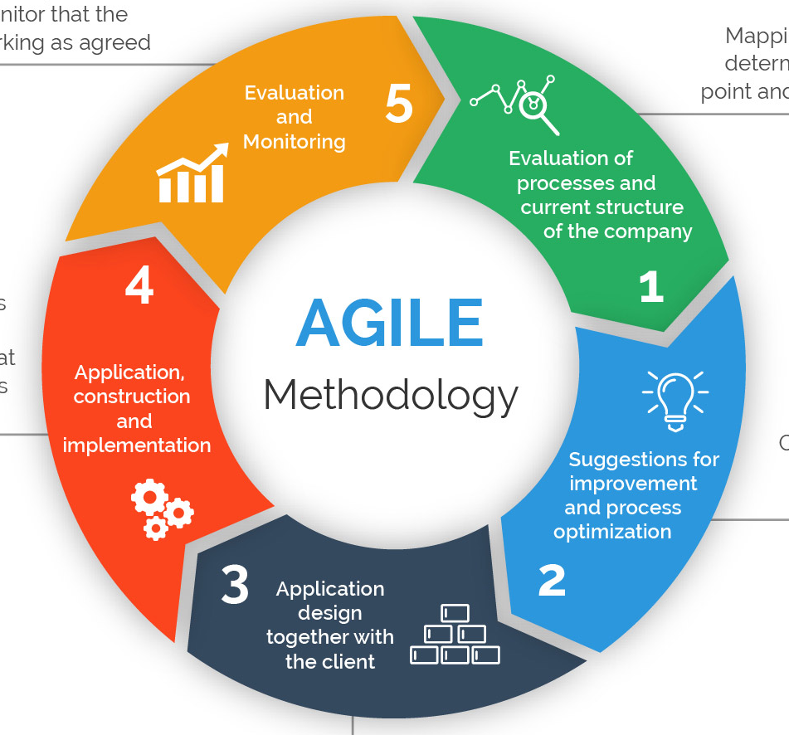
Agile
Analyze Client Domain structure
Provide improvement suggestions for the Domain Processes
Application module prototyping based on suggested improvements
Construction and implementation of Application(s)
Client Evaluation and feedback

Slide 4
Loaf-Go Client Domain
A bread baking factory based out of Long Island City with the means of onsite production and offsite deliveries to clientele across the 5 boroughs. The crux of the business revolves around 5 major clients, with 20 delivery trucks for daily operations. All record keeping is done with pen and paper.
Notes:
Here we discuss the domain and the problem our client is facing. This slide is a little too busy for my taste may need to be changed

Slide 5
The Problem
Loaf-go needs to evolve their business into the 21st century
Incoming and Outgoing Orders
Inventory of raw materials and products produced
Delivery tracking
Goal is to build a web based system in order to increase customer loyalty and expand their clientele

Slide 6
Scope
LoafGo will be used as a non-subscription based SaaS platform. Clients can create an account to place/view orders on your system. With this approach, its easier to scale the software to a much larger platform. Management has the choice to install the system or migrate it to a variety of hosting platforms. We would recommend Microsoft Azure or Amazon AWS.

Slide 7
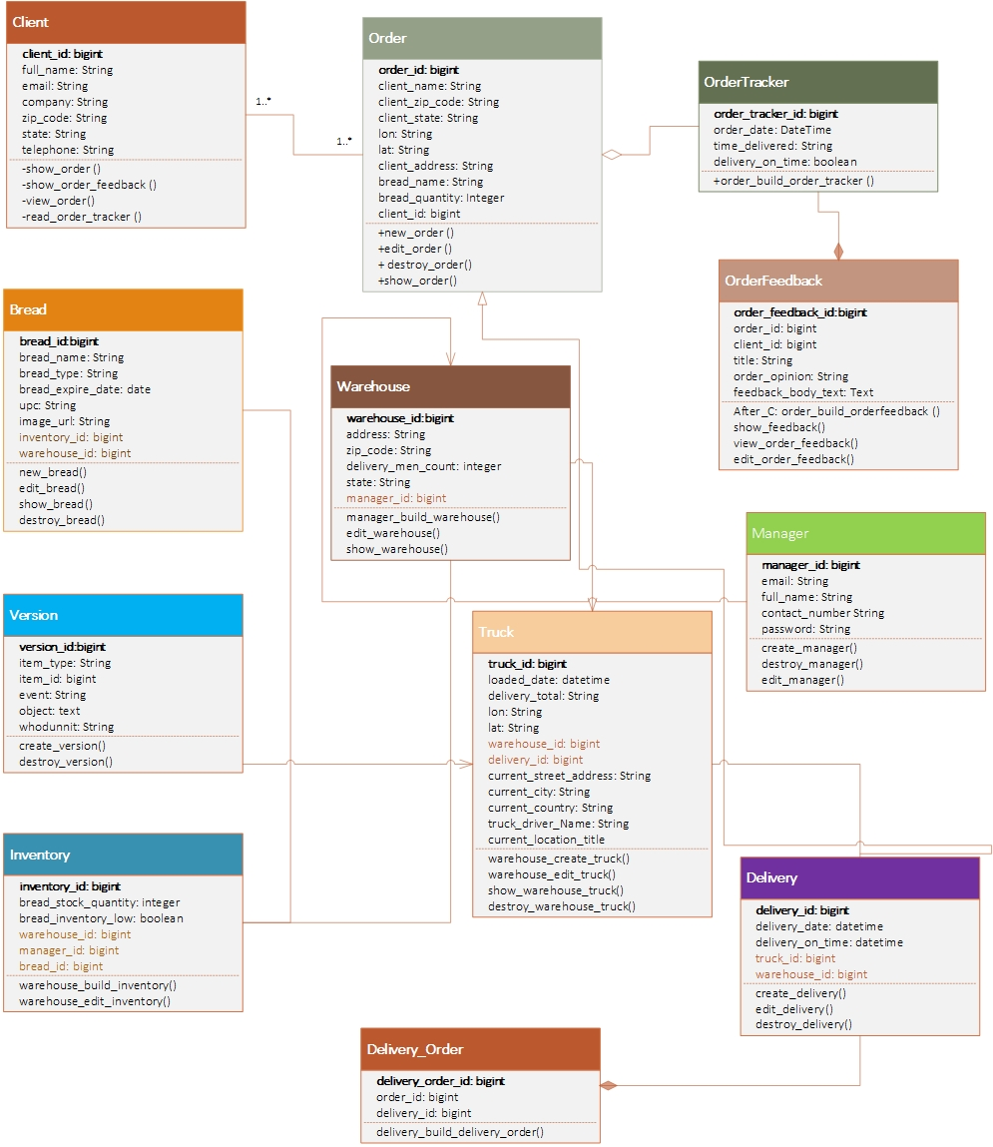
LoafGo Class UML

Slide 8

Thank you for joining us!

